Slide 1
Open Badges
November 19, 2018
Erik van den Broek

Slide 2
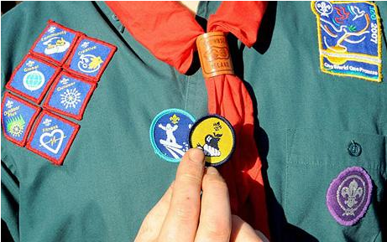
badges are not new…
recognise skills or achievements
visual

Slide 3
… and not only a reward!
long use as a motivation tool in many different disciplines

Slide 4
times are changing…
digital learning environments
digital job application
digital student admission
(scanned paper diploma)

Slide 5
something new is needed
a digital certificate that is:
visual
secure
offered by a new standard:
OBI - open badge infrastructure
a common framework for the issuing,
collection, and display of digital badges
(originally developed by MacArthur and Mozilla Foundations → non profit! )

Slide 6
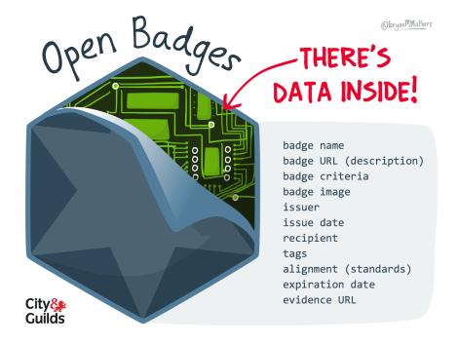
open badge anatomy
an image
“baked” with data
→ made unchangeable!
name
description
issuer
criteria
evidence
{valid thru}
etc ….

Slide 7
how a badge might look:
“I can solve almost all problems that arise when using digital technology. I can choose the right tool, device, application, software or service to solve (non-technical) problems. I am aware of new technological developments. I understand how new tools work. I frequently update my digital skills.”
issued by: EuropeanElectronics Ltd
issued to: Piet Jansen
issuing date: November 20, 2018
valid thru: November 20, 2023

Slide 8
what do you need?
As an organisation:
an issuing platform
(many tools/factories available)
As an earner:
a backpack / e-portfolio
(many options available)

Slide 9
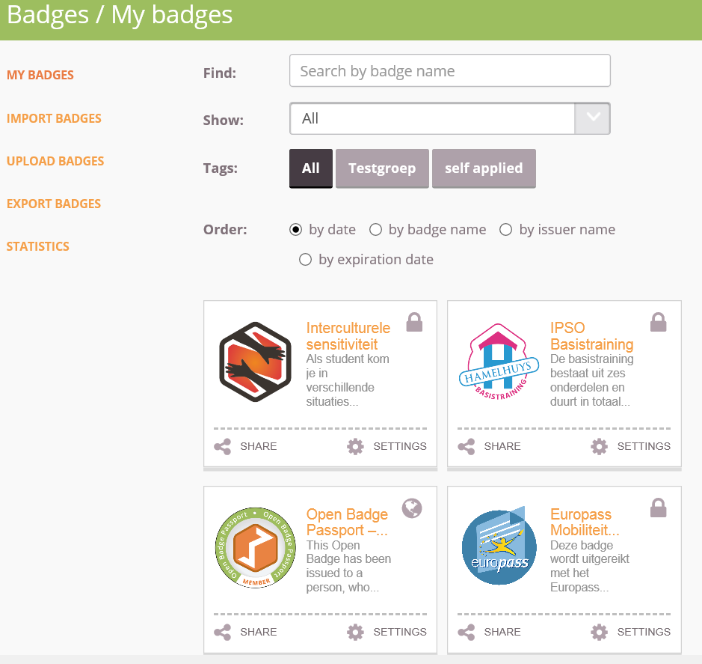
backpack

Slide 10
share on?
social media
digital cv
eportfolio
personal blog

Slide 11
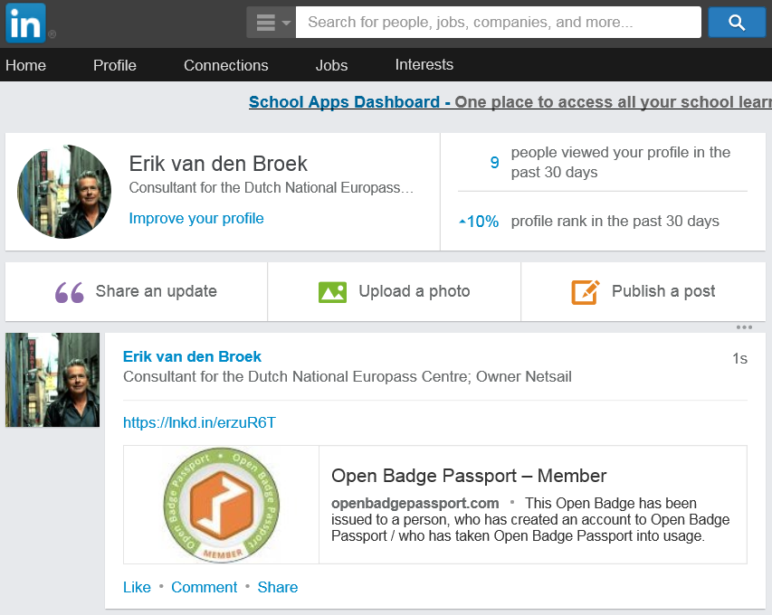
.

Slide 12
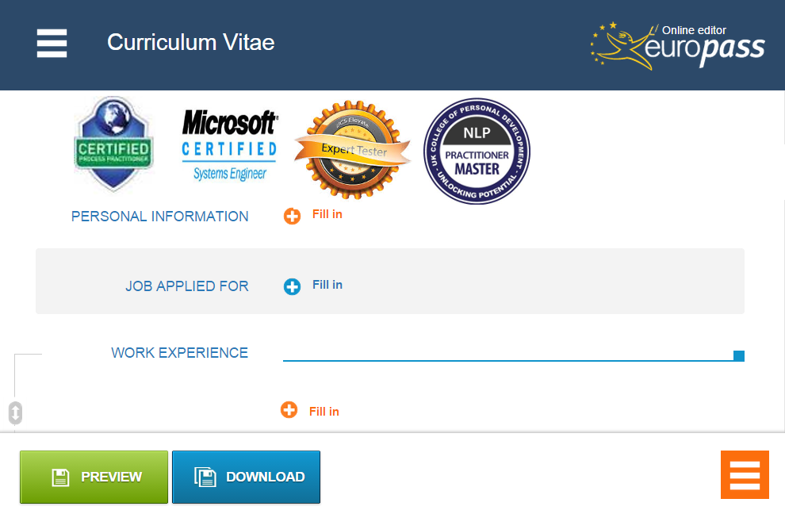
* functie wordt beschreven in competenties
* competenties worden “gebadged”
* te behalen badges worden gepubliceerd

Slide 13
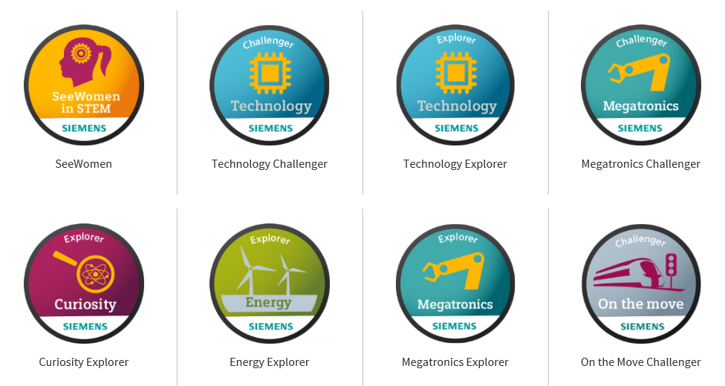
popularity

Slide 14
adoption by EU
Europass… since 2005, a portfolio for LLL
essentially paper based
10 years later “not fit for purpose”
2018 May: New Europass Decision
direction: a secure digital portfolio
Europass CV with badges
→ applying for a job with credentials!2018

Slide 15
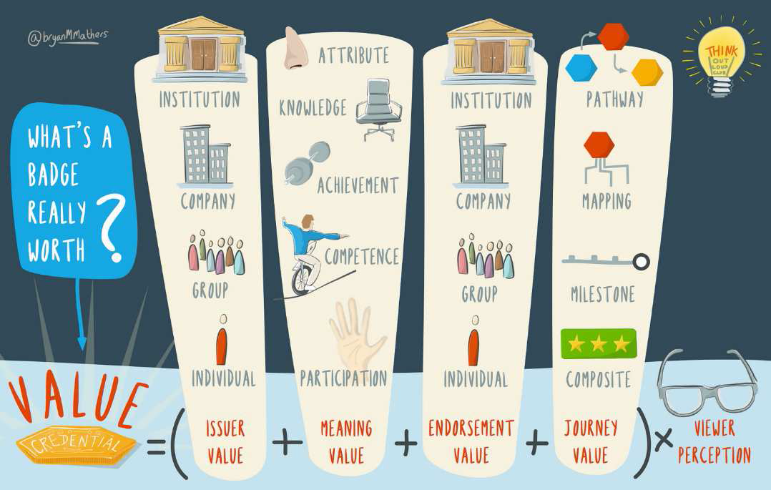
value

Slide 16
Also value increasing: Standardisation
Competency Frameworks are “badgeable”

Slide 17
Example: DigComp
framework for digital competence of individuals
first published in 2013,
describes which competences are needed today
for work, learning, leisure, inclusion and participation
5 competence areas, 3 levels (originally)
integrated within the Europass CV (self assessment)

Slide 18
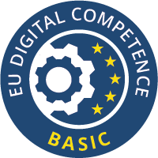
DigComp – Information processing
Information and data literacy
Browsing, searching and filtering data, information and digital content
Evaluating data, information and digital content
Managing data, information and digital content

Slide 19
DigComp – Three levels
Basic user: I can look for information online using a search engine. I know not all online information is reliable. I can save or store files or content (e.g. text, pictures, music, videos, web pages) and retrieve them once saved or stored.
Proficient user: I can use advanced search strategies (e.g. using search operators) to find reliable information on the internet. I can use web feeds (like RSS) to be updated with content I am interested in. I can assess the validity and credibility of information using a range of criteria. I am aware of new advances in information search, storage and retrieval. Ι can save information found on the internet in different formats. I can use cloud information storage services.

Slide 20
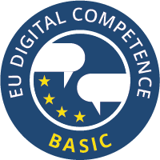
DigComp - Communication
Communication and collaboration
Interacting through digital technologies
Sharing through digital technologies
Engaging in citizenship through digital technologies
Collaborating through digital technologies
Netiquette
Managing digital identity

Slide 21
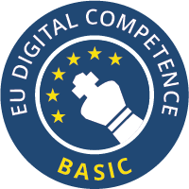
DigComp – Problem solving
Problem solving
Solving technical problems
Identifying needs and technological responses
Creatively using digital technologies
Identifying digital competence gaps

Slide 22
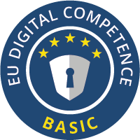
DigComp - Safety
Safety
Protecting devices
Protecting personal data and privacy
Protecting health and well-being
Protecting the environment

Slide 23
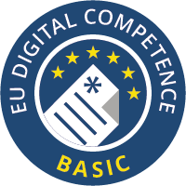
DigComp – Content creation
Digital content creation
Developing digital content
Integrating and re-elaborating digital content
Copyright and licences
Programming

Slide 24
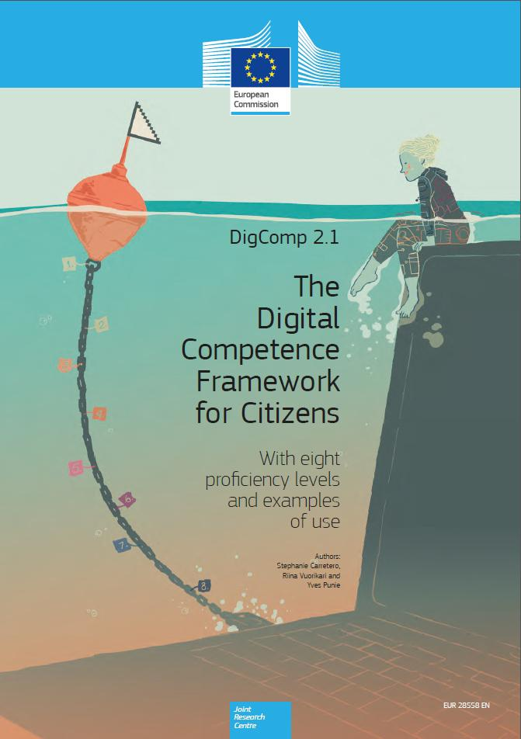
DigComp 2.1

Slide 25
Open Badges ‘the new
currency
for learning’

